Slide 1



自然語言處理與應用 Natural Language Processing and Applications
Hugging Face Tutorial (II)
Instructor: 林英嘉 (Ying-Jia Lin)
2025/04/28
Course GitHub
Slido # NLP_0428

Slide 2
What you will learn in this tutorial
Training and evaluating GPT-2 / T5 on abstractive summarization
Dataset: Chinese abstractive summarization
Objective: Cross-entropy
Main packages: PyTorch, Hugging Face, ROUGE

Slide 3
Why do we need to learn GPT-2?
GPT-2 is the last open-source model in the GPT series from OpenAI.
Language generation is hard, and GPT-2 is a good start point.
GPT-2 is not big. It is feasible for low-budget machines.
GPT-2 (12-layer; 124M), GPT-2-medium (24-layer; 345M), GPT-2-large (36-layer; 762M), GPT-2-xl (48-layer; 1.5B)

Slide 4
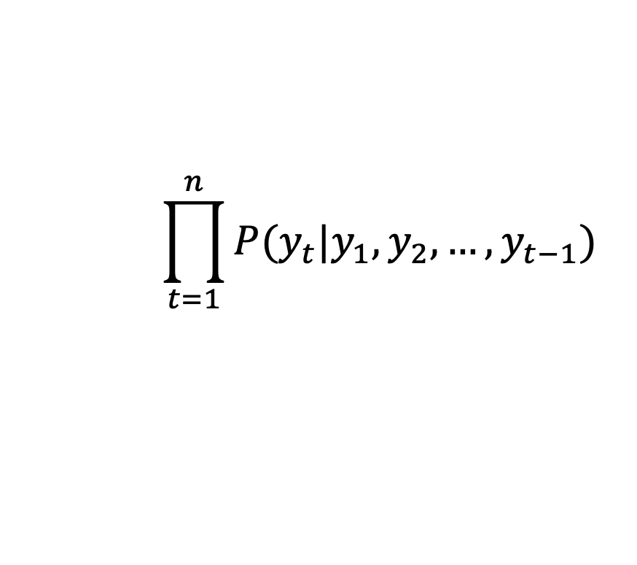

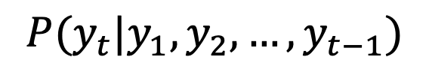
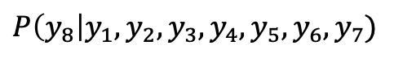
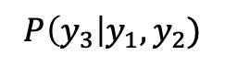
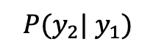
[Recap] 訓練模型最大化每個時間點的機率
模型如何進行預先訓練 (pre-training)？
$$P(y_{t}|y_{1},y_{2},…,y_{t−1})$$
Next-token prediction
$$P(y_{2}| y_{1})$$
$$P\left(y_{3}\right|y_{1},y_{2})$$
$$⋅⋅⋅$$
$$P\left(y_{8}\right|y_{1},y_{2},y_{3},y_{4},y_{5},y_{6},y_{7})$$
y₂
y₃
y₄
y₅
y₆
y₇
y₈
目標函數：
Language Model
$$\prod_{t=1}^{n}{P(y_{t}|y_{1},y_{2},…,y_{t−1})}$$
Language Modeling
y₁
y₂
y₃
y₄
y₅
y₆
y₇
= Generative Pre-training (GPT)
Self-attention 不可及的範圍

Slide 5
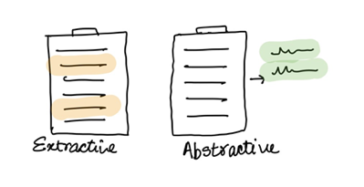
Introduction to Text Summarization
Extractive summarization
Generate a short text summary for a document by selecting salient sentences in the documents.
Abstractive summarization
Generate novel words and phrases not featured in the source text.
Example:
The Queen's Birthday holiday road toll stands at zero for the first time since records began.
Ext summary: The Queen's holiday road toll stands at zero.
Abs summary: The Queen's holiday slashes road toll.

Slide 6
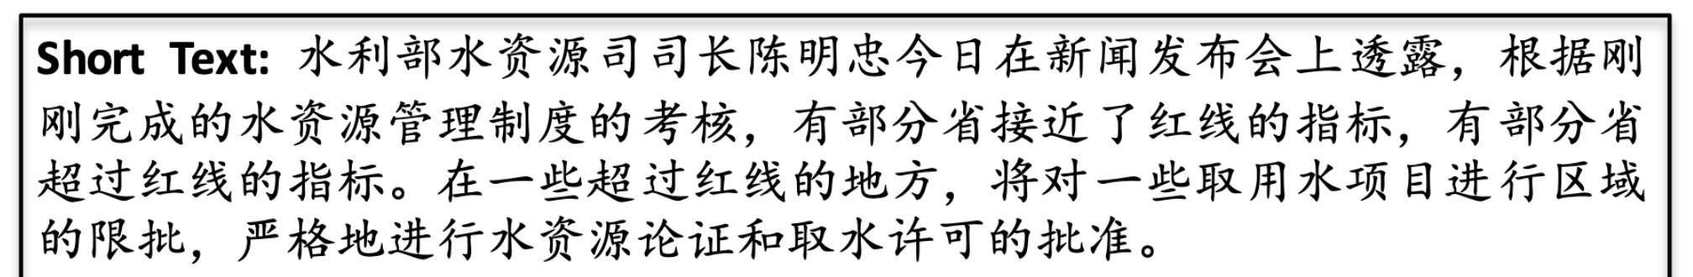
Task: Chinese Abstractive Summarization
Dataset: LCSTS (A Large-Scale Chinese Short Text Summarization Dataset)^{[1]}
[1] Hu, Baotian, Qingcai Chen, and Fangze Zhu. "LCSTS: A Large Scale Chinese Short Text Summarization Dataset." Proceedings of the 2015 Conference on Empirical Methods in Natural Language Processing. 2015.

Slide 7
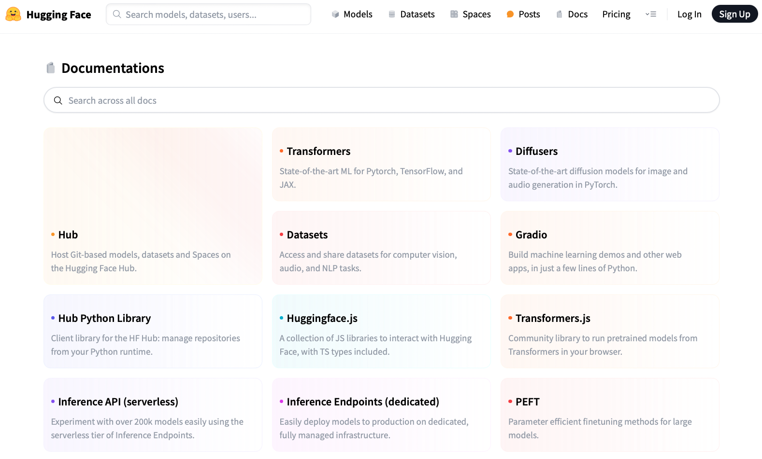
https://huggingface.co/docs

Slide 8
Installation
Basically, you need to install PyTorch first before you install transformers.
(Recommended)
pip install transformers
(If you want to try new things)
git clone https://github.com/huggingface/transformers.git
cd transformers
pip install -e .

Slide 9
Packages required in this tutorial
We need the following packages for this tutorial. On Colab, you may not need to re-install these packages for they may have already been installed.
!pip install torch==2.3.1 --index-url https://download.pytorch.org/whl/cu121
!pip install transformers==4.37.0
!pip install datasets==2.21.0
!pip install accelerate==0.21.0
!pip install rouge==1.0.1
!pip install tqdm==4.66.5
!pip install jieba==0.42.1

Slide 10
Language Model vs. Masked Language Model
y₂
y₃
y₄
y₅
y₆
y₇
y₈
Casual Language Model
(E.g., GPT)
Language Model
y₁
y₂
y₃
y₄
y₅
y₆
y₇
y₄
Masked Language Model
(E.g., BERT)
Masked Language Model (MLM)
y₁
y₂
y₃
?
y₅
y₆
y₇
(Mask)

Slide 11
Language Model vs. Seq2seq Model
y₂
y₃
y₄
y₅
y₆
y₇
y₈
Casual Language Model
(E.g., GPT)
Language Model
y₁
y₂
y₃
y₄
y₅
y₆
y₇
(Target output)
y₁
y₂
y₃
y₄
y₅
y₆
y₇
y₈
Sequence to sequence Model
(E.g., T5; Vanilla Transformers)
Encoder
Decoder
Attention
x₁
x₂
x₃
x₄
x₅
x₆
x₇
x₈
_
y₁
y₂
y₃
y₄
y₅
y₆
y₇
(Source input)
(Start)

Slide 12
Load LCSTS via Hugging Face Dataset
Hugging Face dataset link
raw_train = load_dataset(
"hugcyp/LCSTS", split="train", cache_dir="./cache/"
).to_list()
raw_val = load_dataset(
"hugcyp/LCSTS", split="validation", cache_dir="./cache/"
).to_list()
Sometimes checking the Hugging Face dataset is slow, it will be faster if we transform the dataset object into a list using .to_list().

Slide 13
Let’s try it
1. 用 load_dataset() 把 train 和 validation 分開讀進來
2. 把 dataset 轉成 pandas dataframe，觀察 1~2 筆 samples

Slide 14
Auto Classes (models, tokenizers)
In many cases, the architecture you want to use can be guessed from the name or the path of the pretrained model you are supplying to the from_pretrained method.
AutoClasses are here to do this job for you so that you automatically retrieve the relevant model given the name/path to the pretrained weights/config/vocabulary:
Ex: model = AutoModel.from_pretrained('bert-base-cased') will create an instance of the BERT base model (cased).
https://huggingface.co/transformers/v3.0.2/model_doc/auto.html

Slide 15
Generative Models in Auto Classes
Casual Language Model
(E.g., GPT, Llama)
AutoModelForCausalLM (link)
GPT2LMHeadModel (link)
LlamaForCausalLM (link)
Masked Language Model
(E.g., BERT)
AutoModelForMaskedLM (link)
BertForMaskedLM (link)
Sequence to sequence Model
(E.g., T5; Vanilla Transformers)
AutoModelForSeq2SeqLM (link)
T5ForConditionalGeneration (link)

Slide 16
Outline
GPT-2 (native PyTorch)
T5 (Hugging Face Dataset and Trainer)

Slide 17
Import packages
from transformers import AutoTokenizer
from transformers import GPT2LMHeadModel
from datasets import load_dataset
from tqdm import tqdm
import torch
from torch.utils.tensorboard import SummaryWriter
from rouge import Rouge
import jieba

Slide 18
Load the Tokenizer and the Model
Hugging Face model link
model_name = "uer/gpt2-chinese-cluecorpussmall"
tokenizer = AutoTokenizer.from_pretrained(
model_name,
padding_side="left”,
)
tokenizer.add_special_tokens({"eos_token": "<|endoftext|>"})
model.resize_token_embeddings(len(tokenizer))
Optional

Slide 19
Let’s try it
1. 載入模型
2. print 出 model config

Slide 20
Left padding
In text generation, sometimes we set padding_side=’left', when loading tokenizer.
If padding is at the end of the prompt, new tokens may be generated after the padding, which is illogical.
<s> | Recite | the | first | law | <s> | <pad> | <pad> | <pad>
<s> | How | are | you | <s> | <pad> | <pad> | <pad> | <pad>
<s> | Who | is | the | first | president | of | U.S. | <s>
Left-padding
Aligning the new tokens.
<pad> | <pad> | <pad> | <s> | Recite | the | first | law | <s>
<pad> | <pad> | <pad> | <pad> | <s> | How | are | you | <s>
<s> | Who | is | the | first | president | of | U.S. | <s>

Slide 21
About Padding
 | Fine-tuning | Test time (inference)
策略一 | Left padding + set [PAD] as -100 in labels (this tutorial) | Left padding
策略二 | Right padding + set [PAD] as -100 in labels | Use test_batch_size as 1 (this tutorial)
Fine-tuning 的策略一可搭配 Test time 的任一策略
Fine-tuning 的策略二只建議搭配 Test time 的策略二

Slide 22
Set [PAD] as -100 in labels
https://github.com/huggingface/transformers/blob/main/src/transformers/models/gpt2/modeling_gpt2.py#L1264-L1267
r"""
labels (`torch.LongTensor` of shape `(batch_size, sequence_length)`, *optional*):
Labels for language modeling. Note that the labels **are shifted** inside the model, i.e. you can set
`labels = input_ids` Indices are selected in `[-100, 0, ..., config.vocab_size]` All labels set to `-100`
are ignored (masked), the loss is only computed for labels in `[0, ..., config.vocab_size]`
"""

Slide 23
Load the Tokenizer and the Model
Hugging Face model link
model_name = "uer/gpt2-chinese-cluecorpussmall"
tokenizer = AutoTokenizer.from_pretrained(
model_name,
padding_side="left”,
)
tokenizer.add_special_tokens({"eos_token": "<|endoftext|>"})
model.resize_token_embeddings(len(tokenizer))
Increasing the size will add newly initialized vectors at the end. Reducing the size will remove vectors from the end. (link)

Slide 24
resize_token_embeddings
新增 embedding 的情況：
^{新增的 embedding 還沒有被訓練過}
透過 torch 的 nn.Embedding 來新增 token 的向量
https://github.com/huggingface/transformers/blob/v4.51.3/src/transformers/modeling_utils.py#L2802-L2807
torch 的 nn.Embedding 的初始化範圍是 normal distribution 0到1之間

Slide 25
Let’s try it
1. 載入 tokenizer
2. 測試句子：「今天天氣真好」，print 出 tokenized tokens

Slide 26
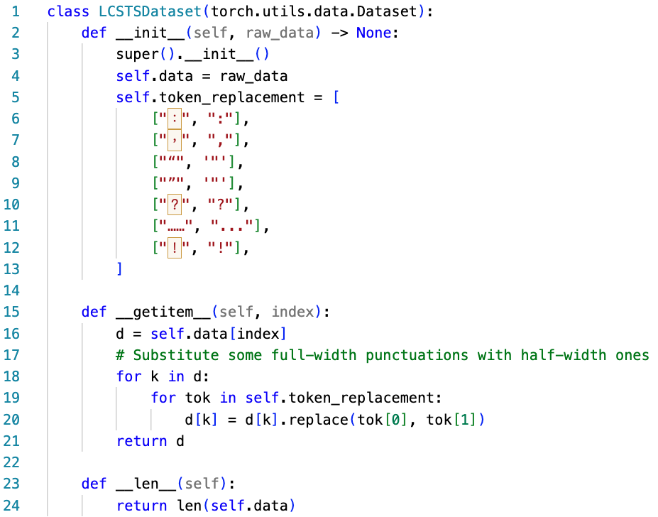
Create the PyTorch Dataset
To prevent out-of-vocabulary tokens from being transformed into [UNK]
You can use the Hugging Face dataset without building a PyTorch dataset class.
However, language generation is really complicated. We suggest building your first code with native PyTorch.
Run:
train_set = LCSTSDataset(raw_train)
val_set = LCSTSDataset(raw_val)

Slide 27
Create the PyTorch DataLoader for Data Batching
Input data for training (source + summary)
Labels (auto-regressive; thus, basically input_ids themselves)
Input data for predictions (source only)

Slide 28
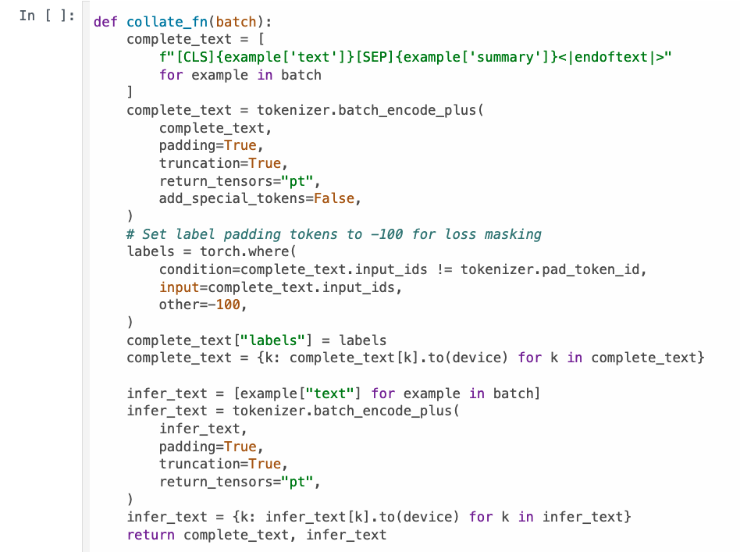
Overview
1
2
3

Slide 29
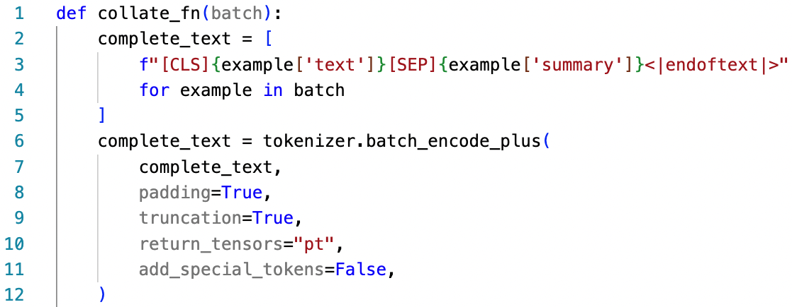
Create the PyTorch DataLoader for Data Batching: 1. Input Data for Training
You can omit the [CLS] token before fine-tuning!
[CLS]
Source article
[SEP]
Summary
<|endoftext|>

Slide 30
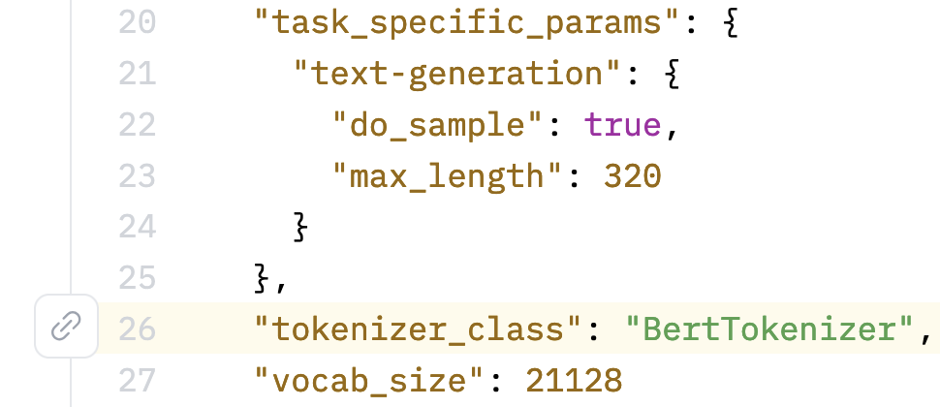
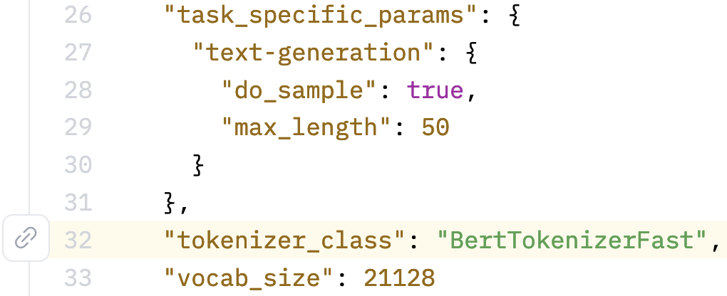
uer/gpt2-chinese-cluecorpussmall uses BertTokenizer
https://huggingface.co/uer/gpt2-chinese-cluecorpussmall/blob/main/config.json#L26
https://huggingface.co/ckiplab/gpt2-base-chinese/blob/main/config.json#L32

Slide 31
English GPT-2 for Text Summarization^{[2]}
> To induce summarization behavior, we can add the text TL;DR: after the article ^{[2]}
TL;DR
Ideally, the model may learn [SEP] as a signal to perform summarization.
[CLS]
Source article
[SEP]
Summary
<|endoftext|>
(You can try it.)
Ideally, the model may learn <|endoftext|> as a signal to end generation.
[2] Radford, A., Wu, J., Child, R., Luan, D., Amodei, D., & Sutskever, I. (2019). Language models are unsupervised multitask learners. OpenAI blog, 1(8), 9.

Slide 32
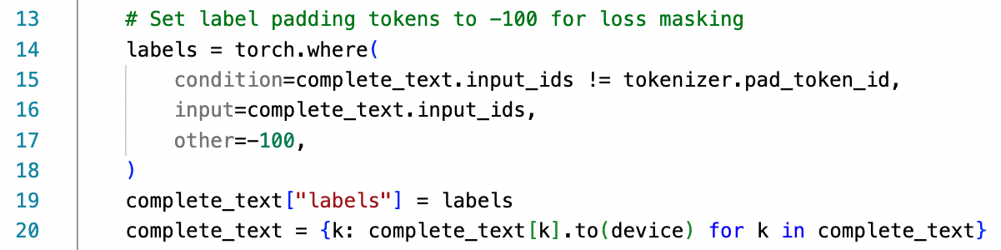
Create the PyTorch DataLoader for Data Batching: 2. Labels (auto-regressive)
(We are still at the collate_fn function.)
this is sentence a
[PAD]
[PAD]
this
is
sentence
a
labels
-100
-100
1212
318
6827
317
this is is is sentence b
this
is
is
is
sentence
b
labels
1212
318
318
318
6827
347

Slide 33
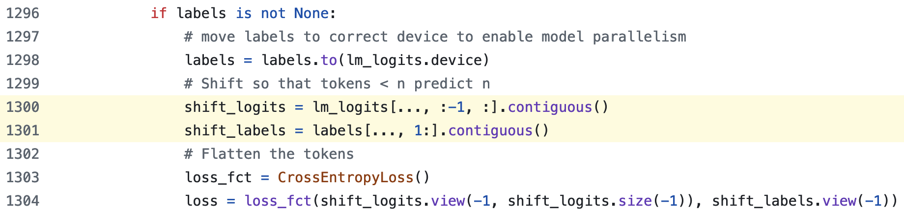
GPT2LMHeadModel shifts logits and labels
https://github.com/huggingface/transformers/blob/main/src/transformers/models/gpt2/modeling_gpt2.py#L1300-L1301
Shape of lm_logits: [batcg_size, seq_length, hidden_size]
:-1 代表取到倒數第二個
1: 代表答案後移一格
.contiguous(): https://youtu.be/FGJSGAt_9Ks?si=GMxxS2Oi742e2BhI&t=1261

Slide 34
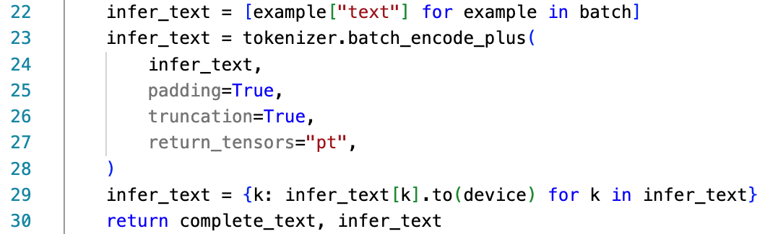
Create the PyTorch DataLoader for Data Batching: 3. Input Data for Predictions
(We are still at the collate_fn function.)
We will use `infer_text` during evaluations.
If you omit the [CLS] token during fine-tuning, then you don’t need to add [CLS] before evaluations!
[CLS]
Source article
[SEP]
Summary
<|endoftext|>

Slide 35
Create the PyTorch DataLoader for Data Batching: 1. Input Data for Training [Recap]
You can omit the [CLS] token before fine-tuning!
[CLS]
Source article
[SEP]
Summary
<|endoftext|>

Slide 36
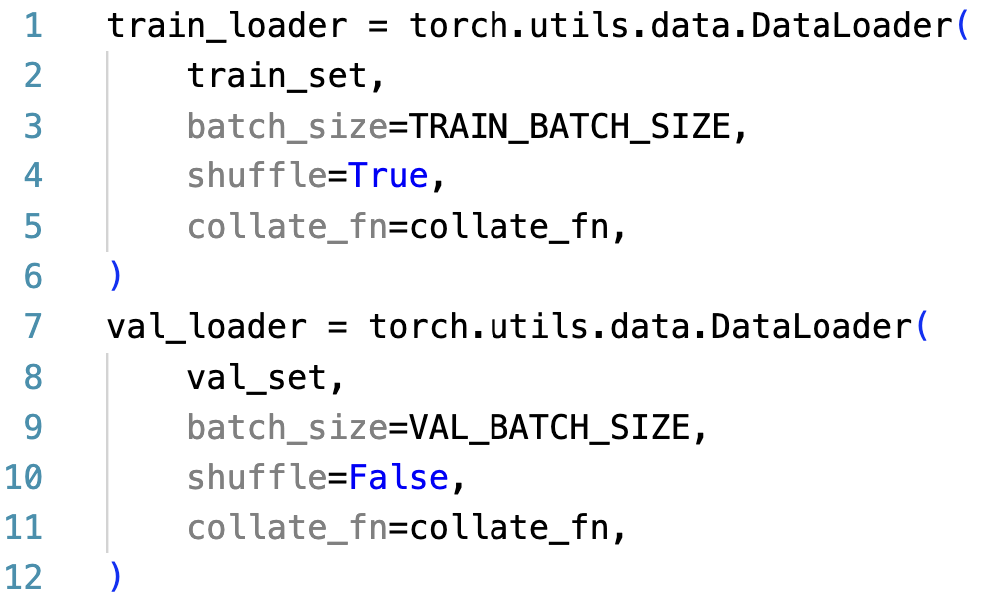
Create the PyTorch DataLoader for Data Batching
Prevent a model from overfitting on data order
We don’t need to use the test set because there is no public test labels (summaries).
See https://huggingface.co/datasets/hugcyp/LCSTS/viewer/default/test

Slide 37
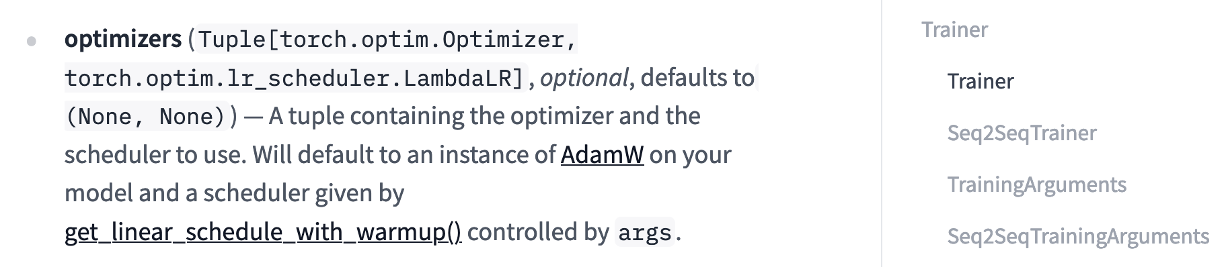
Set up Optimizer
optimizer = torch.optim.AdamW(model.parameters(), lr=LR)
https://pytorch.org/docs/stable/generated/torch.optim.AdamW.html
https://huggingface.co/docs/transformers/main_classes/trainer

Slide 38
Let’s try it
1. 開 train 一下模型

Slide 39
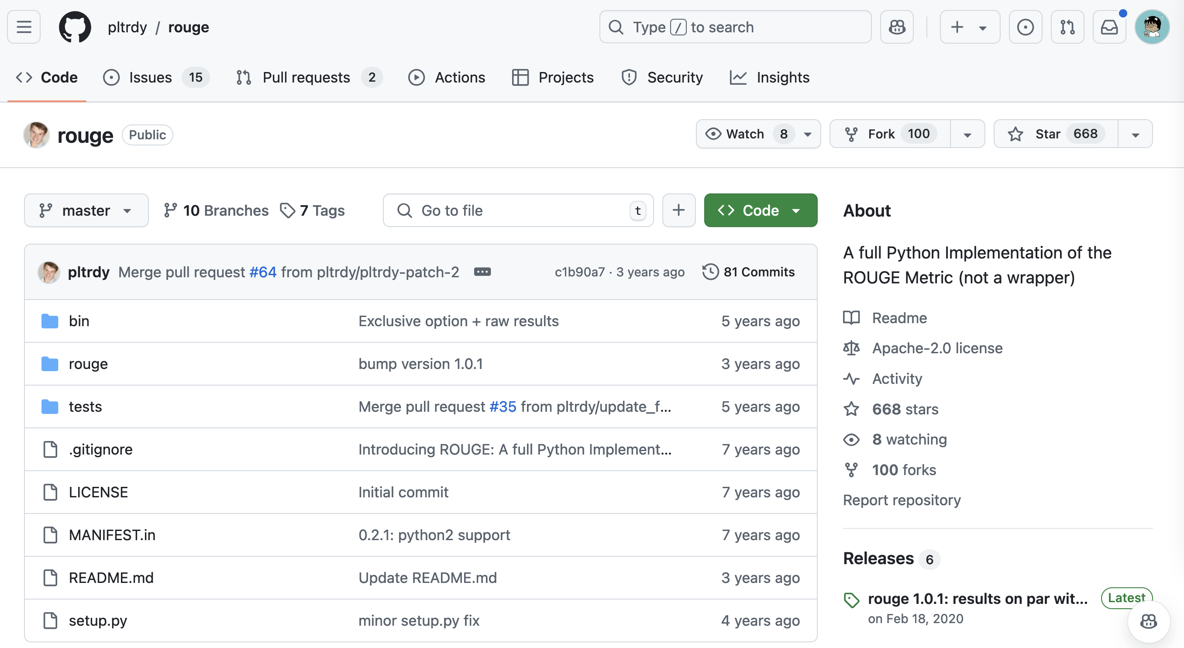
Set up Evaluation Metric
rouge_metric = Rouge()
https://github.com/pltrdy/rouge

Slide 40
ROUGE Score^{[3]}
ROUGE (Recall-Oriented Understudy for Gisting Evaluation)
Mainly for text summarization
Metric Input: Summary (prediction), Reference (gold summary)
Common metrics: ROUGE-1, ROUGE-2, ROUGE-L
L: Longest common subsequence
Please note that current papers calculate ROUGE-F as default!!!
In other words, ROUGE-1F, ROUGE-2F, ROUGE-LF
Lin, Chin-Yew. "Rouge: A package for automatic evaluation of summaries." Text summarization branches out. 2004.

Slide 41
ROUGE-1 Example
predictions = ["The", "cat", "sat", "on", "the", "mat"]
references = ["A", "cat", "was", "sitting", "on", "the", "mat"]
ROUGE-1 recall = Number of matching unigrams / Number of unigrams in the reference = 4/7
ROUGE-1 precision = Number of matching unigrams / Number of unigrams in the machine-generated summary = 4/6
ROUGE-1 F1-score = Harmonic mean of the precision and the recall = 2 * 4/7 * 4/6 / (4/7 + 4/6)

Slide 42
Generating step-by-step
y₁
y₂
y₃
y₄
y₅
y₆
y₇
y₈
Casual Language Model
(E.g., GPT)
Language Model
_
y₁
y₂
y₃
y₄
y₅
y₆
y₇
Training time: update the model through hidden states
Test time: perform decoding for each step

Slide 43
Decoding strategies
Popular decoding strategies:
Greedy decoding
Beam search
Top-k sampling
Top-p sampling
https://huggingface.co/blog/how-to-generate

Slide 44
How to let a model generate step-by-step?
We can use model.generate()
There are two main advantages of model.generate():
We don’t need to write a decoding loop on our own.
We don’t need to implement decoding strategies by ourselves.
[Useful!!] https://huggingface.co/blog/how-to-generate

Slide 45
Pseudo code of a decoding loop
for step in range(max_length):
# Forward pass through the model
outputs = model.decoder(
input_ids=decoder_input_ids,
encoder_outputs=encoder_outputs
)
# Take the last hidden state's logits
logits = outputs.logits[-1] # shape: (vocab_size,)
# Apply softmax to get probabilities (optional, since argmax is invariant)
probs = softmax(logits)
# Select the token with the highest probability (greedy decoding)
next_token_id = argmax(probs)
# Append the predicted token to the decoder inputs
decoder_input_ids.append(next_token_id)
# If EOS token is generated, stop decoding
if next_token_id == EOS_TOKEN_ID:
break

Slide 46
Perform Evaluations
Input:
[CLS]
Source article
[SEP]
Expected output of model.generate():
[CLS]
Source article
[SEP]
Summary
<|endoftext|>
Gold:
Summary

Slide 47
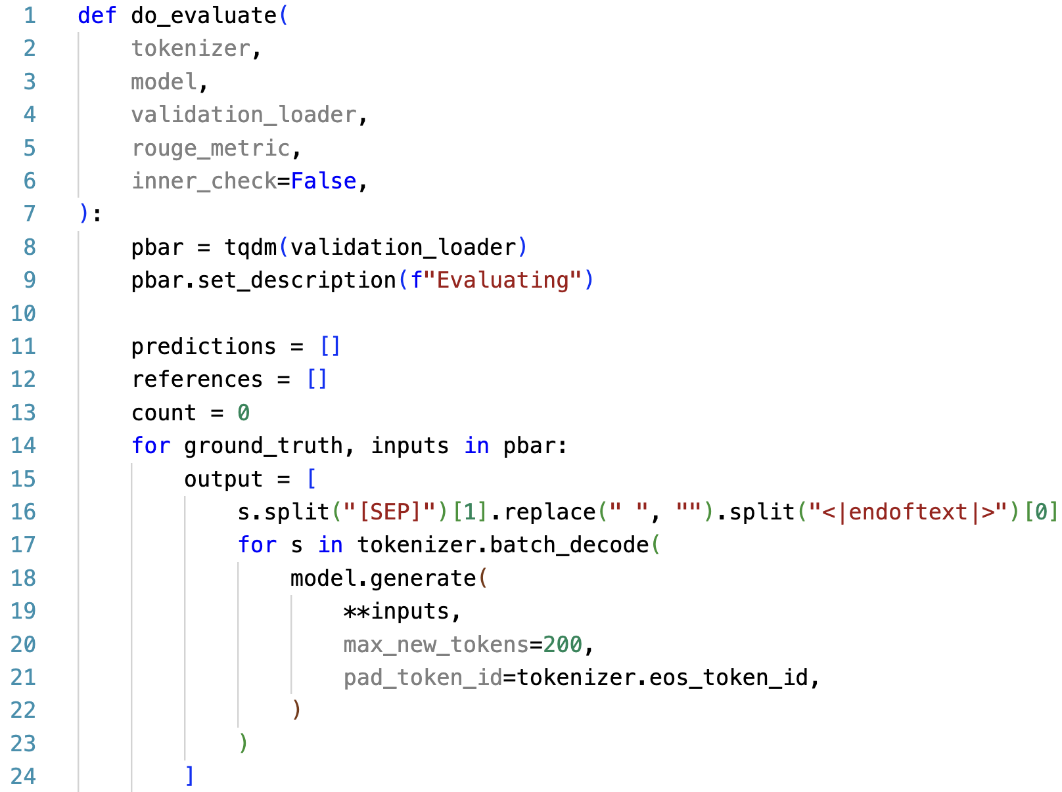
Perform Evaluations
Output Part
Expected output of model.generate():
[CLS]
Source article
[SEP]
Summary
<|endoftext|>

Slide 48
Create the PyTorch DataLoader for Data Batching: 3. Input Data for Predictions
(We are still at the collate_fn function.)
We will use `infer_text` during evaluations.
If you omit the [CLS] token during fine-tuning, then you don’t need to add [CLS] before evaluations!
[CLS]
Source article
[SEP]
Summary
<|endoftext|>

Slide 49
Perform Evaluations
If you don’t set max_new_tokens, Hugging Face will also count the input tokens!
Output Part

Slide 50
Perform Evaluations
For each batch, first finished sentences should have <|endoftext|> rather than [PAD] at the end.
Output Part
More details: https://github.com/huggingface/transformers/blob/b880508440f43f80e35a78ccd2a32f3bde91cb23/src/transformers/generation_utils.py#L1248-L1251

Slide 51
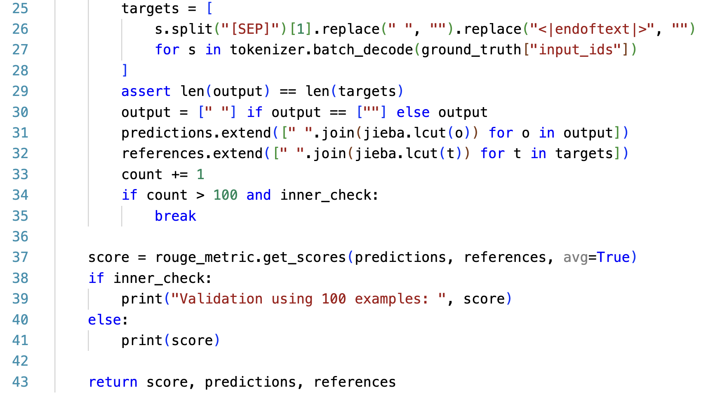
Perform Evaluations
Target and Scoring Parts
ground_truth:
[CLS]
Source article
[SEP]
Summary
<|endoftext|>

Slide 52
Perform Evaluations
Target and Scoring Parts
Character-level bi-gram: (「看」、「電」)(「電」、「視」)
Word-level bi-gram: (「看」、「電視」)

Slide 53
Perform Evaluations
Target and Scoring Parts
avg=True: perform averaging for all the tested instances

Slide 54
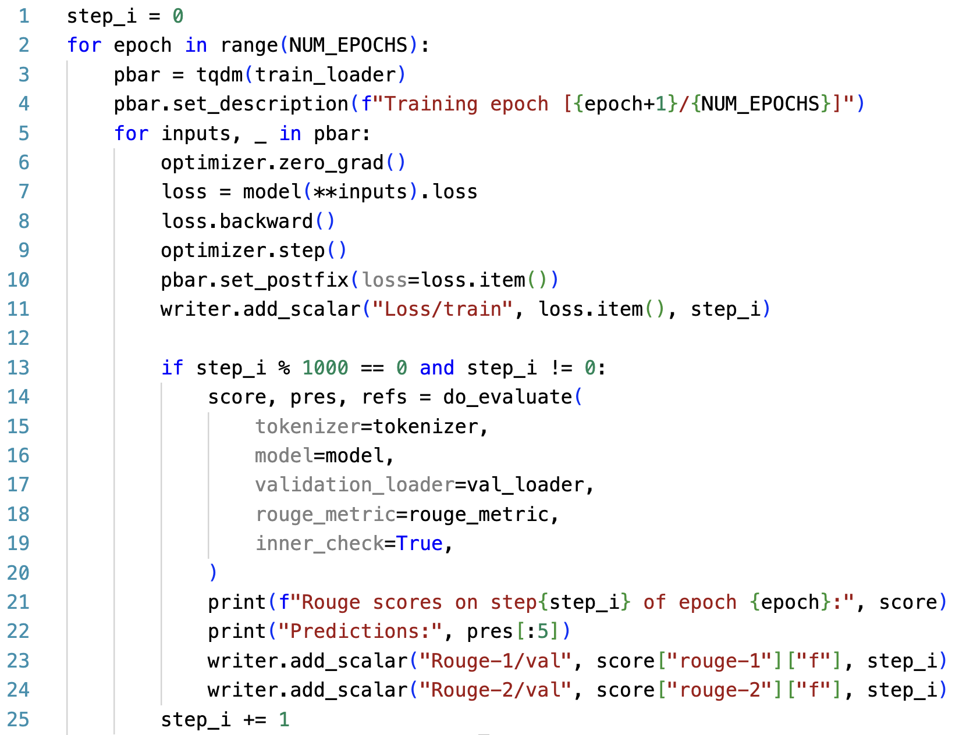
Training Loop
Evaluating the subset of the validation data at each 1,000 steps

Slide 55
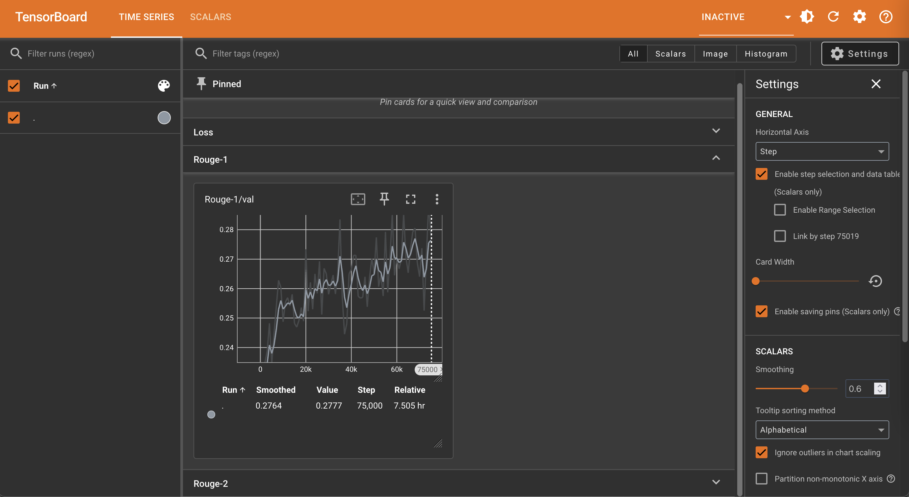

Slide 56
Let’s try it
1. 看一下你自己的 tensorboard

Slide 57
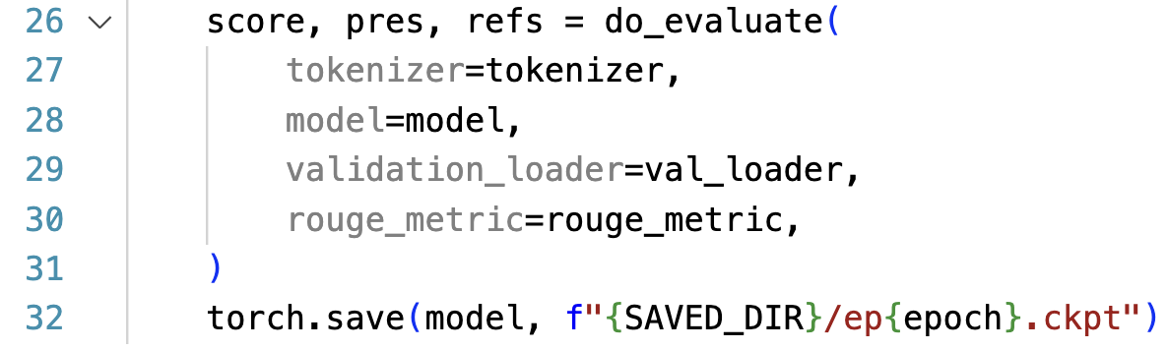
Training Loop
Evaluating the full validation set at each end of epoch

Slide 58
Outline
GPT-2 (native PyTorch)
T5 (Hugging Face Dataset and Trainer)

Slide 59
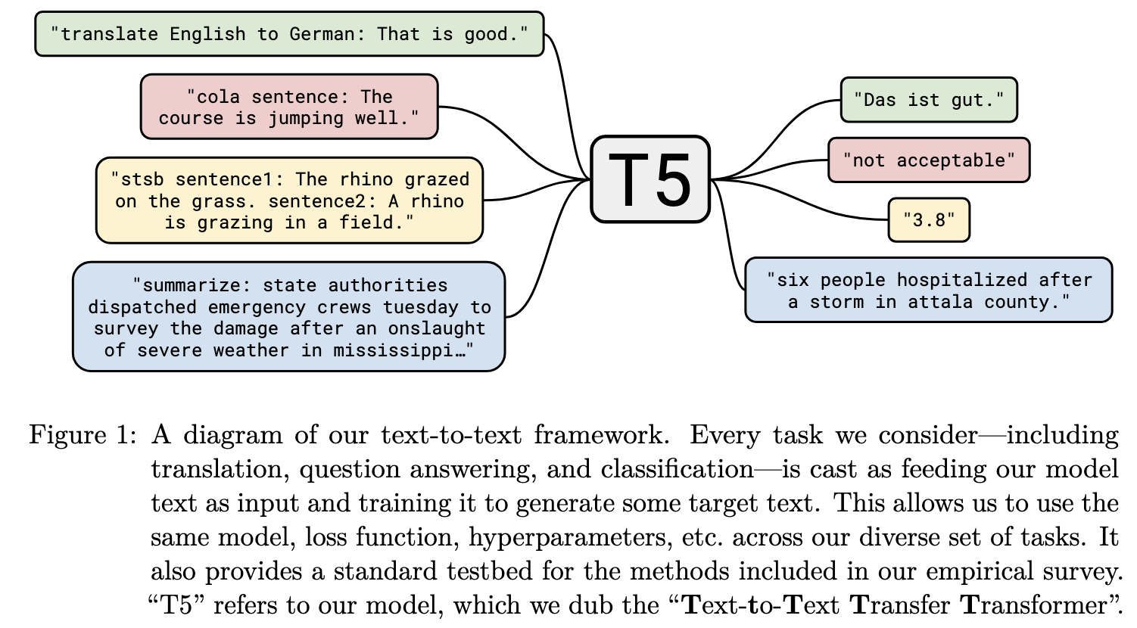
T5 ^{[4]}
[4] Raffel, Colin, et al. "Exploring the limits of transfer learning with a unified text-to-text transformer." Journal of machine learning research 21.140 (2020): 1-67.

Slide 60
Language Model vs. Seq2seq Model
y₂
y₃
y₄
y₅
y₆
y₇
y₈
Casual Language Model
(E.g., GPT)
Language Model
y₁
y₂
y₃
y₄
y₅
y₆
y₇
(Target output)
y₁
y₂
y₃
y₄
y₅
y₆
y₇
y₈
Sequence to sequence Model
(E.g., T5; Vanilla Transformers)
Encoder
Decoder
Attention
x₁
x₂
x₃
x₄
x₅
x₆
x₇
x₈
_
y₁
y₂
y₃
y₄
y₅
y₆
y₇
(Source input)
(Start)

Slide 61
Import packages
from transformers import AutoTokenizer
from transformers import AutoModelForSeq2SeqLM
from transformers import DataCollatorForSeq2Seq
from transformers import Seq2SeqTrainingArguments
from transformers import Seq2SeqTrainer
from datasets import load_dataset
from rouge import Rouge
import numpy as np
import pickle
import os
import jieba

Slide 62
Load the LCSTS dataset
Hugging Face dataset link
data_name = "hugcyp/LCSTS"
raw_train = load_dataset(data_name, split="train")
raw_valid = load_dataset(data_name, split="validation")
raw_small_valid = raw_valid.select(range(100))
raw_small_valid will be used for inner_check (validation).
We will later process the dataset with the built-in map function, so we don’t use.to_list() here.

Slide 63
Load the Tokenizer and the Model
Hugging Face model link
model_name = "google/mt5-small"
tokenizer = AutoTokenizer.from_pretrained(model_name)
model = AutoModelForSeq2SeqLM.from_pretrained(model_name)
Q1: Do we need left-padding?
A1: No, because we are now using a sequence-to-sequence model, which will first compress input sequences though the encoder.
Q2: Do we need to add [EOS] by ourselves?
A2: No, mT5 has </s> as the [EOS] token.

Slide 64
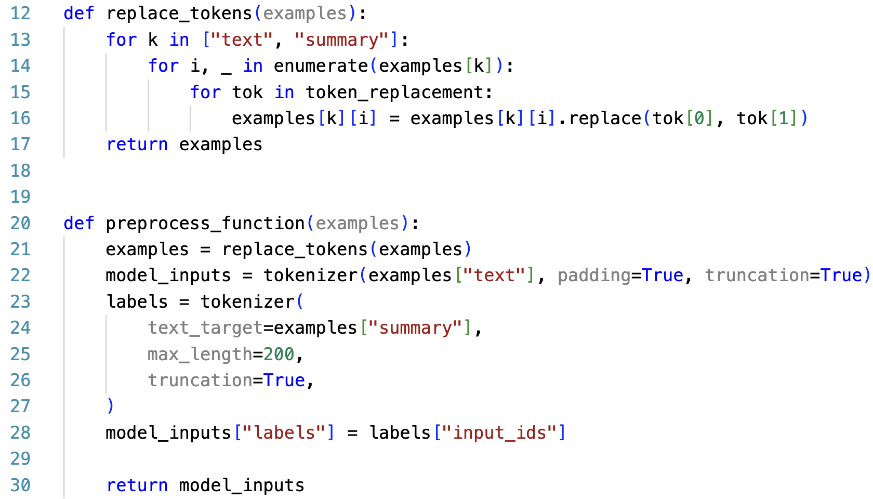
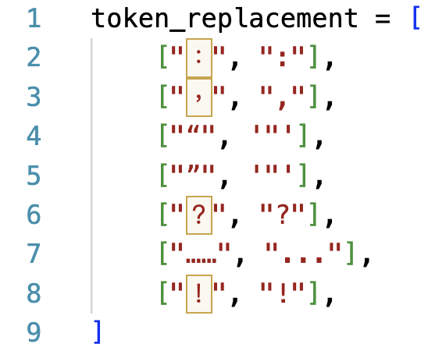
Data pre-processing (inputs; source articles)

Slide 65
Data pre-processing (labels; summaries)

Slide 66
Data pre-processing (executions)
train = raw_train.map(preprocess_function, batched=True)
valid = raw_valid.map(preprocess_function, batched=True)
small_valid = raw_small_valid.map(preprocess_function, batched=True)
data_collator = DataCollatorForSeq2Seq(
tokenizer=tokenizer,
model=model_name,
)
DataCollatorForSeq2Seq dynamically pads batched data and transforms padded labels into -100.
The operation provided by this object does a similar job like collate_fn.

Slide 67
Set up Evaluation Metric
rouge_metric = Rouge()
https://github.com/pltrdy/rouge

Slide 68
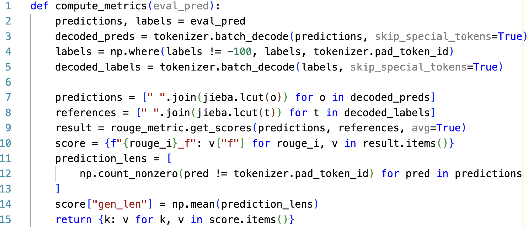
Build compute_metrics for evaluations
-100 is transformed by DataCollatorForSeq2Seq.
Convert labels with -100 to pad_token_id for decoding.

Slide 69
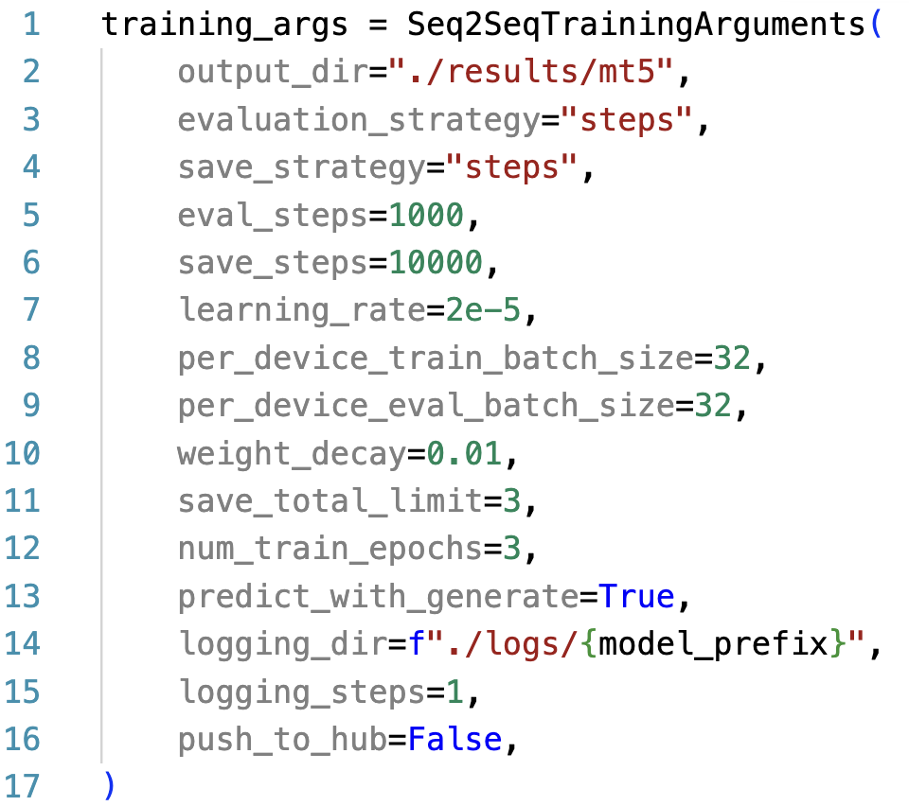
Setting up TrainingArguments (link)
Default using Greedy search. Seq2seqTrainer Supports beam search only.

Slide 70
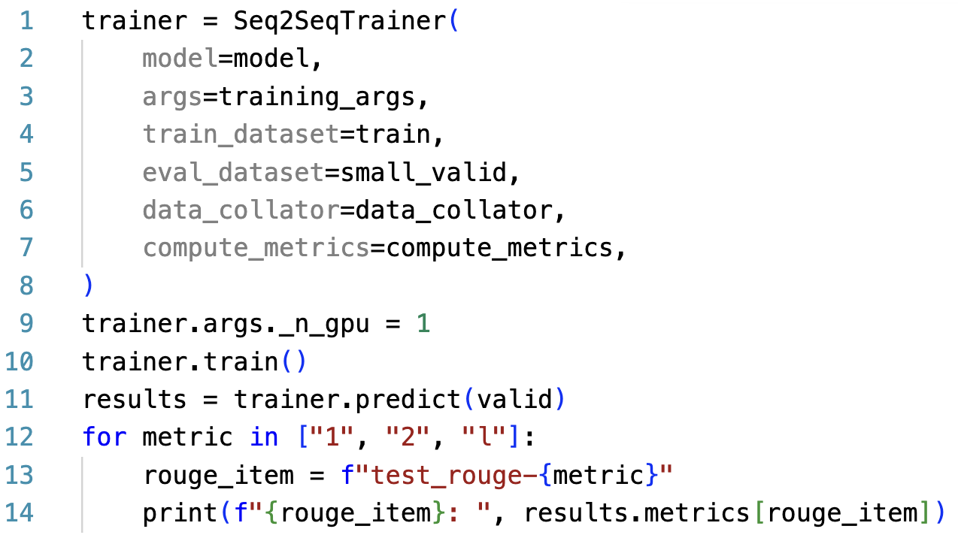
Setting up Trainer (training part)

Slide 71
Setting up Trainer (evaluation part)

Slide 72
Thank you!
Instructor: 林英嘉
✉️ yjlin@cgu.edu.tw
TA: 吳宣毅
✉️ m1161007@cgu.edu.tw

